Slide 1


Kirill Rodion

Slide 2


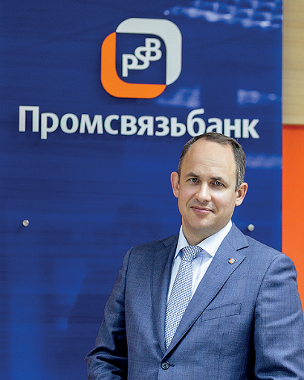

HISTORY
Promsvyazbank is one of the biggest banks in Russia. It was founded in 1995. Initially, he specialized in servicing enterprises in the field of IT and communications
Since the mid-2000s, he began active development as a universal credit institution, becoming one of the top 20 largest banks in Russia.
2010-2015: A period of active expansion through the acquisition of other banks
In December 2017, the Central Bank initiated the bank's reorganization. By May 2018, 100% of the shares had become the property of the Russian Federation in the person of the Federal Property Management Agency
2019: The Bank officially became the main bank for servicing the state defense order and enterprises of the military-industrial complex
On April 2025, the bank changed its official name to PJSC Bank PSB and completed the relocation of its head office from Moscow to Yaroslavl.
Notes:
2
Since its foundation, PSB has developed a network of 43 offices in Moscow and Moscow region (which is geographically our most important market) and has offices in almost all major Russian major cities mainly in the European part of the country, but also in the Far East and Siberia.
As of end of June 2007 we had a total of 150 outlets
This network enables us to operate during business hours in all time zones of the Russian Federation.
As part of our strategy of strengthening our position as a full scale universal bank, we intend to further grow our regional network and increase our presence across Russian regions.
We plan to have [XX] offices and branches by the end of this year, compared to [XX] we have now.
In addition to our domestic presence, we have foreign representative offices in Cyprus, China, India and Ukraine and a network of corresponding banking relations, which allows us to maintain a leading position in clearing services.

Slide 3
TODAY
A universal bank with state participation, whose history spans more than 20 years
A systemically important financial institution
TOP 10 largest banks in Russia
62 regions of presence;
57 offices in Moscow and the Moscow region
250,000 clients-legal entities
More than 130,000 open checking accounts
Notes:
3
Since its foundation, PSB has developed a network of 43 offices in Moscow and Moscow region (which is geographically our most important market) and has offices in almost all major Russian major cities mainly in the European part of the country, but also in the Far East and Siberia.
As of end of June 2007 we had a total of 150 outlets
This network enables us to operate during business hours in all time zones of the Russian Federation.
As part of our strategy of strengthening our position as a full scale universal bank, we intend to further grow our regional network and increase our presence across Russian regions.
We plan to have [XX] offices and branches by the end of this year, compared to [XX] we have now.
In addition to our domestic presence, we have foreign representative offices in Cyprus, China, India and Ukraine and a network of corresponding banking relations, which allows us to maintain a leading position in clearing services.

Slide 4

Products and services
Provision of services for private individuals:
Loans, mortgages, deposits
Debit and credit cards
Provision of services for businesses:
Cash Settlement service (RKO)
Business cards, loans, acquiring
Providing services for corporations:
Large loans, guarantees
Financing of investments
Notes:
4
Since its foundation, PSB has developed a network of 43 offices in Moscow and Moscow region (which is geographically our most important market) and has offices in almost all major Russian major cities mainly in the European part of the country, but also in the Far East and Siberia.
As of end of June 2007 we had a total of 150 outlets
This network enables us to operate during business hours in all time zones of the Russian Federation.
As part of our strategy of strengthening our position as a full scale universal bank, we intend to further grow our regional network and increase our presence across Russian regions.
We plan to have [XX] offices and branches by the end of this year, compared to [XX] we have now.
In addition to our domestic presence, we have foreign representative offices in Cyprus, China, India and Ukraine and a network of corresponding banking relations, which allows us to maintain a leading position in clearing services.

Slide 5
STATISTICS
21,9%
increase in net profit
26,2%
increasing customers

Slide 6
BANK STRUCTURE
👥 Retail business (servicing individuals)
Sales Department of banking products
Department of lending to individuals
Mortgage Lending Department
Debit and Credit Card Department
Department for raising funds for deposits
💼 Corporate unit (working with companies)
Department of work with large business
Small and Medium Business Service Department
Cash Management Department
Corporate Lending Department
Government Contract Support Department
⚖️ Risk Management Unit
Credit Risk Department
Market Risk Department
Department of Operational Risks
Department of scoring and evaluation of borrowers
📊 Financial block
Accounting Department
Financial Planning Department
Management Reporting Department
Treasury
Tax Accounting Department
🖥️ IT department
Software Development and Implementation Department
Business Intelligence Department
Cybersecurity Department
24/7 System Monitoring Service
Technical Support Department
🛠️ Auxiliary units
Legal Department
Internal Control Service
Administrative and Economic Department
Human Resources Department (HR)
Security Service

Slide 7
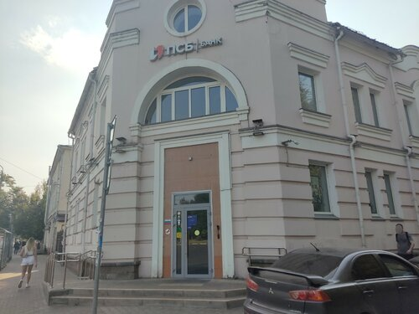
Conclusion
In conclusion, Promsvyazbank is not just a financial institution. It is also a technology company that invests in digital transformation and in young talent. PSB Bank is a great place to work, where you can develop your professional skills in the field of information security. Our different roles, in DevOps and Network Engineering, show how many opportunities there are in the bank for IT specialists.
Notes:
7
Since its foundation, PSB has developed a network of 43 offices in Moscow and Moscow region (which is geographically our most important market) and has offices in almost all major Russian major cities mainly in the European part of the country, but also in the Far East and Siberia.
As of end of June 2007 we had a total of 150 outlets
This network enables us to operate during business hours in all time zones of the Russian Federation.
As part of our strategy of strengthening our position as a full scale universal bank, we intend to further grow our regional network and increase our presence across Russian regions.
We plan to have [XX] offices and branches by the end of this year, compared to [XX] we have now.
In addition to our domestic presence, we have foreign representative offices in Cyprus, China, India and Ukraine and a network of corresponding banking relations, which allows us to maintain a leading position in clearing services.

Slide 8
Thanks for your attention
Notes:
8
Since its foundation, PSB has developed a network of 43 offices in Moscow and Moscow region (which is geographically our most important market) and has offices in almost all major Russian major cities mainly in the European part of the country, but also in the Far East and Siberia.
As of end of June 2007 we had a total of 150 outlets
This network enables us to operate during business hours in all time zones of the Russian Federation.
As part of our strategy of strengthening our position as a full scale universal bank, we intend to further grow our regional network and increase our presence across Russian regions.
We plan to have [XX] offices and branches by the end of this year, compared to [XX] we have now.
In addition to our domestic presence, we have foreign representative offices in Cyprus, China, India and Ukraine and a network of corresponding banking relations, which allows us to maintain a leading position in clearing services.

